Slide 1
Data Transformation and Enrichment with OpenRefine: Part 2: Enhancing data
Ryan Mendenhall
Columbia University Libraries
October 10, 2018
Notes:
My name is Ryan Mendenhall, I work as a Metadata Librarian with digital collections at Columbia University. Thanks for attending!

Slide 2
Outline for the Workshop
Part 1:
Intros / About OpenRefine / Setting Up the Workspace / Review of key concepts from last week’s workshop
Part 2:
About Reconciliation / Reconciliation and other enhancement techniques
Notes:
Before we get started with introductions, we’d like to provide a brief overview of the structure for today’s activities. . .

Slide 3
Introductions
Name
CUL Location / job
Comfort level with linked data
Working on a project that could incorporate external data?
Notes:
Who was here last week?
Round Robin of attendees:
Name, place of work/type of work, [low,medium,high] comfort level with linked data, a bit about a project you’re working on or would like to work on that makes use of LOD, if any

Slide 4
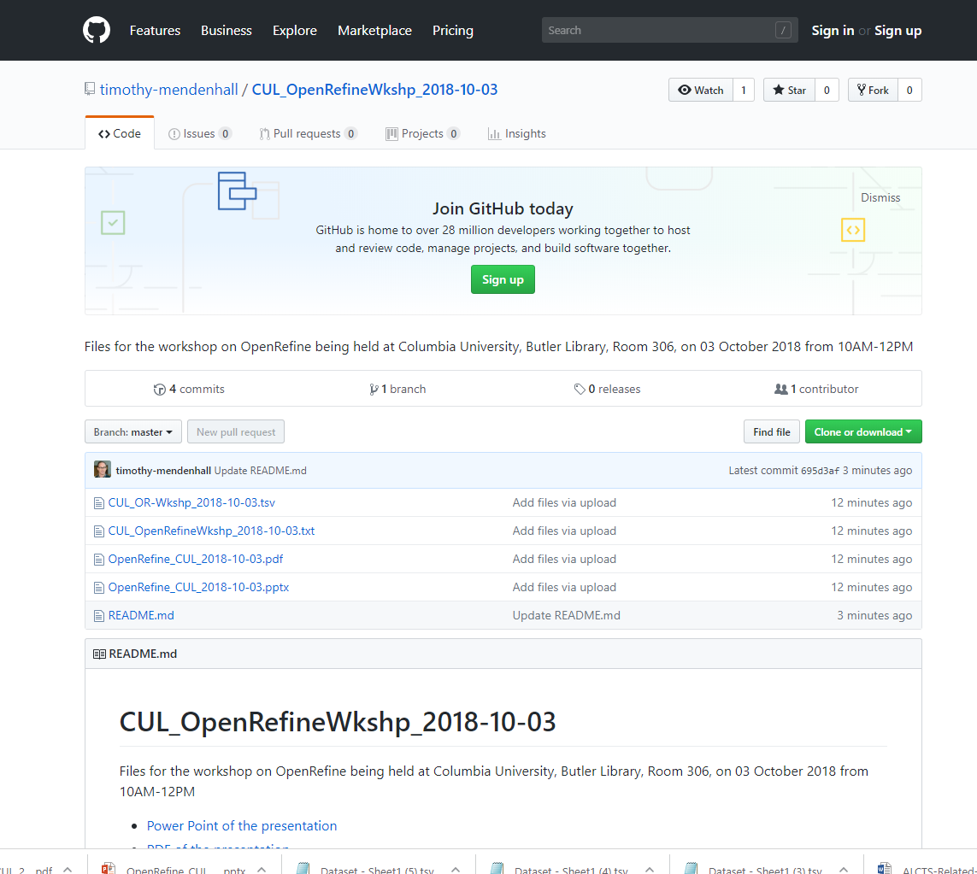
Today’s Workspace
Download the workshop files https://bit.ly/2C5FybG
Right click: Winzip → Extract all
Notes:
RM

Slide 5
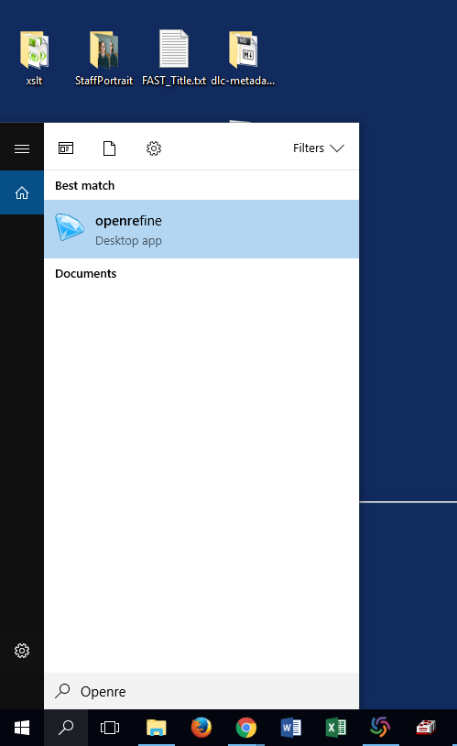
Import data and create project
Start the OpenRefine program
If the browser window doesn’t open: http://127.0.0.1:3333
Import the dataset file and create a project (encoding Unicode, Tabs as delimiters, no quotes) using: CUL_OpenRefineWkshp_2018-10-10.tsv
We’ll use a second dataset for an exercise:
Import and create a project called CUL_DLC_Locations using
CUL_DLC_Locations.tsv
Notes:
Now we will begin by creating our first project. Double click the OpenRefine diamond in your applications folder. If a browser window does not open, type in http://127.0.0.1:3333 or http://localhost:3333. I have numerous projects I’ve already created, but you probably don’t. Click on “Create Project “on the left, and select the dataset file you downloaded. Click next.
Now you’ll see a preview screen. Don’t worry; it only shows 100 rows, but they are all there! As you see on the left, OpenRefine has automatically figured out that our file is a tab-separated file. Under Parse data as, you can see a comprehensive list of the other file types OpenRefine is able to open.
Click on the character encoding box, which opens a list of options. I have been bedeviled by character encoding issues in the past, so we can’t emphasize enough how important this is. UTF-8 is usually a safe bet.
Another option to be mindful of is the “Quotation marks are used to enclose cells containing column separators”--this will often cause errors in reading your data if your data includes any quotation marks. I usually uncheck this item. If you ever create a project, but it has fewer rows than your source data, it’s possible that OpenRefine misinterpreted a quotation mark.
On the right, a box is checked for parse next 1 lines as headers. You can configure this if you have, for example, two rows of headers.
Below, make sure that “Parse cell text into numbers, dates, …” is unchecked. This is an example of the software trying to be helpful, but it can wreak havoc on data like accession numbers.
If you’d like, you can change the name of the project, which has automatically been populated with the filename. I usually leave the filename as the project name, but it is up to you. Now you’re ready to click create project!
After creating the project, do you notice any inconsistent or messy data that we could clean up?
What seems familiar from GoogleSheets (or Excel), what is unfamiliar?
(5 minute break)

Slide 6
Scope of exercises
Dataset adapted from an import spreadsheet created for RBML’s Hubert H. Harrison Papers to upload content into CUL’s Digital Library Collections (DLC)
4 methods of “reconciling” data: reconciliation service, API call, SPARQL endpoint, “crossing” with a second dataset

Slide 7

Review: What is OpenRefine?
History: Freebase Gridworks → GoogleRefine → OpenRefine
Currently on version 2.8
Runs in the browser at http://127.0.0.1:3333
GREL: Google Refine Expression Language
Formats: delimited text (CSV, TSV), Excel, XML, JSON, RDF, web services / APIs / endpoints
Documentation: GitHub, Website, email list, books (see resource list)
Image by Google Inc. [BSD (http://opensource.org/licenses/bsd-license.php)], via Wikimedia Commons
Notes:
Let’s briefly review what OpenRefine is.
As we’ll see today, OpenRefine is a powerful tool; although it looks like a familiar spreadsheet tool, it’s much more than that.
An open source project originally developed in 2010 first by Metaweb Technologies and subsequently by Google, in 2012 Google stepped away from the project and it became OpenRefine. We are currently on version 2.8
There is an active developer community supporting the product, and it features various plugins, reconciliation services (which we’ll cover in part 2), and can support more complicated scripting.
When you open OpenRefine, the application starts up and opens a Graphical User Interface in your browser at the local address http://127.0.0.1:3333
Many of OpenRefine’s processes make use of GREL, or General Refine Expression Language, which we’ll get into later on in the workshop.
OpenRefine can handle a variety of file formats: delimited text (CSV, TSV), Excel, XML, JSON, RDF, web services / APIs / endpoints
There is quite a lot of documentation for OpenRefine, some of which we’ll point to at the end of today’s session in a resources section.

Slide 8
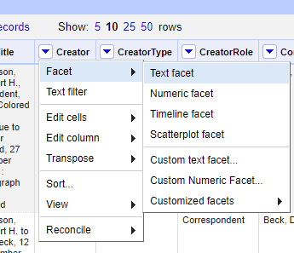
Review: Faceting
Facets are like filters:
If your data has facets applied, OpenRefine will ignore any rows not included in the facets when reconciling, exporting, or performing any other transformations.
Notes:
Live demo: Let’s look at the subject colu

Slide 9
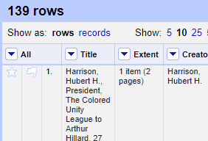
Review: Rows and records
If you have “split” multivalued cells, keep in mind the following when faceting:
In record view, any row with a matching value in a multi-valued cell is included in a facet, including all “sibling” values in a multi-valued cell
In row view, only the matching values, not their “parent” rows or “sibling” values in their shared cells, are included in a facet

Slide 10
Linked Data: the basics
Basis: RDF triples model, “subject predicate object [SPO],” ideally all of which are represented as URIs
[S] Charles Dickens [P] is author of [O] Oliver Twist →
http://id.loc.gov/authorities/names/n78087607 :: http://id.loc.gov/vocabulary/relators/aut :: http://id.loc.gov/authorities/names/nr98012622
Vocabularies: BIBFRAME, CIDOC-CRM, RDF serializations of standards like MODS (underlying CUL’s Digital Library Collections)
Formats: RDF-XML, JSON-LD, N-Triples, Turtle, and others. But can also be represented in a spreadsheet

Slide 11
Linked Data: some examples
SNAC
WorldCat Works and WorldCat Identities
Smithsonian American Art Museum online collections
Wikidata/Wikipedia/DBPedia
CUL: Hyacinth uses URIs, but doesn’t expose linked data
Notes:
The focus of today’s workshop will be the use of OpenRefine for “reconciliation,” often a key step on the way to creating linked [open] data. In reconciliation, we take our [textual] data and query an external published dataset to retrieve the URIs needed for any linked data implementation. In the previous slide, we briefly talked about the structure of linked data; now, let’s look at some examples of linked data implementations or experiments. Linked data is already around us
SNAC: search for Rosa Luxemburg
WorldCat Works and WorldCat Identities: http://www.worldcat.org/oclc/975481514 leading to: http://experiment.worldcat.org/entity/work/data/6553657
Smithsonian American Art Museum online collections search for Lee Krasner
Wikidata/Wikipedia/DBPedia search for Octavia Butler ; dbpedia link: http://dbpedia.org/page/Octavia_E._Butler
Linked Jazz

Slide 12





Controlled Vocabularies
Notes:
So what vocabularies are there to query? Here are some vocabularies that are published as linked open data.

Slide 13
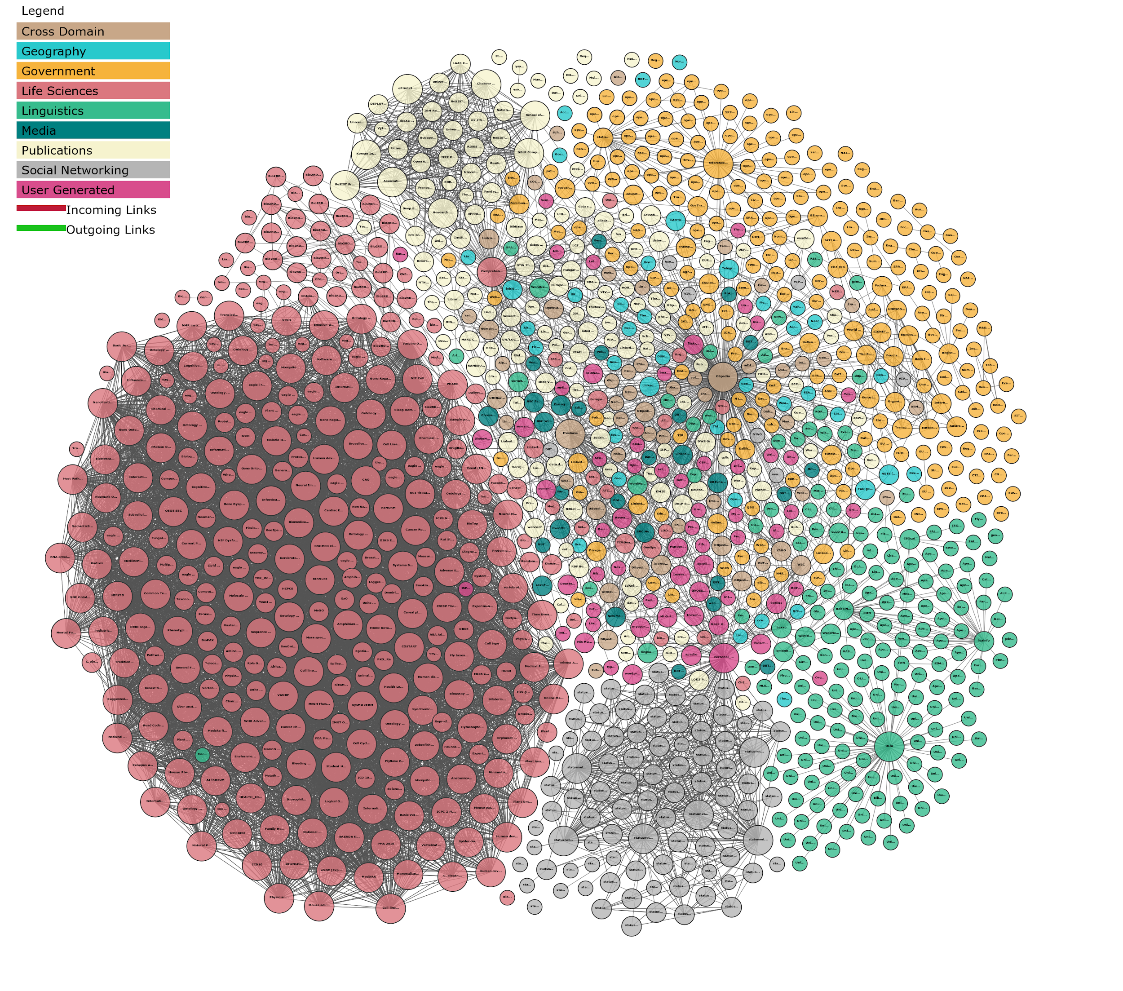
"Linking Open Data cloud diagram 2017, by Andrejs Abele, John P. McCrae, Paul Buitelaar, Anja Jentzsch and Richard Cyganiak. http://lod-cloud.net/"
Notes:
You can find lots more linked open data vocabularies in the Linked Open Data Cloud (here’s a representation of that)

Slide 14

What is Reconciliation?
Notes:
Let’s take a minute to define reconciliation, a key focus of today’s workshop. Would anyone be willing to share what you think this term means?

Slide 15
Reconciliation is a semi-automated process of matching text names to database IDs (keys).
https://github.com/OpenRefine/OpenRefine/wiki/Reconciliation
Notes:
As explained on the OpenRefine wiki, “Reconciliation is a semi-automated process of matching text names to database IDs (keys).”

Slide 16
A reconciliation service is a web service that, given some text which is a name or label for something, and optionally some additional details, returns a ranked list of potential entities matching the criteria.
https://github.com/OpenRefine/OpenRefine/wiki/Reconciliation-Service-API
Notes:
This description is from the technical OpenRefine documentation

Slide 17
Reconciliation services
Reconciliation service queries a published linked data source
Reconciliation service performs fuzzy matching of our local data’s names against the published vocabulary’s names
Reconciliation service scores the returned matches and returns the top 3
In the returned results, you can access the following properties: id, name, type, and score
Reconciliation service simplifies quality checking of matches by providing a human-friendly interface to explore returned matches
OpenRefine 2.8 includes a Wikidata reconciliation service
Notes:
Here’s how I understand it. Reconciliation in our context is matching names in dataset A with names in dataset B and grabbing some data from dataset B.
So this is what happens when we reconcile with OpenRefine
Reconciliation service queries linked open data controlled vocabulary
Reconciliation service performs fuzzy matching of our data’s names against the vocabulary’s names
Reconciliation service returns results with some kind of match confidence indication so they can be curated by us in OpenRefine
We’ll use OpenRefine to extract data from the reconciliation result (in this case URIs)
Export from OpenRefine
Finally, Import new data into your system

Slide 18
conciliator
Reconciliation service by Jeff Chiu
http://refine.codefork.com
VIAF and LC/NAF by way of VIAF proxy
http://refine.codefork.com/reconcile/viaf
http://refine.codefork.com/reconcile/viafproxy/LC
Other possibilities: ORCiD, OpenLibrary, anything in VIAF via VIAF proxy
Notes:
This is a reconciliation service created by Jeff Chiu. It’s awesome and I find it’s fast and easy to use. Right now we’ll use the public service that Jeff set up; this is for small-scale usage, like the 30-100 records we’re working with in this workshop. If you will be reconciling a large number of records, he’s made the code available on Github and you can set up a local reconciliation service on your own computer and not tax his public server. You can find the instructions for doing that on Jeff’s github, linked to from this page.
A quick note that Jeff’s service also provides a way to get not just VIAF URIs, but the source URIs from VIAF contributors like Library of Congress [LC/NAF] or Getty [ULAN]. You do that by using his “viafproxy” URL.
URLS
http://refine.codefork.com/reconcile/viaf
http://refine.codefork.com/reconcile/viafproxy/LC
http://refine.codefork.com/reconcile/viafproxy/JPG
But for now let’s copy the link he has for plain old VIAF (number 1 on the slide). These links are also included in the text file in the Dropbox link you downloaded earlier.

Slide 19
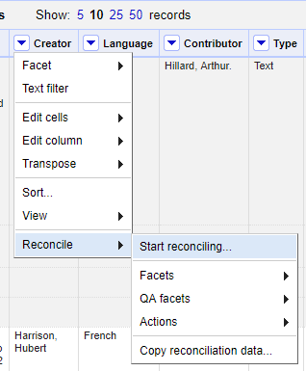
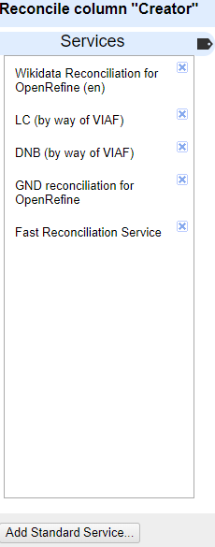
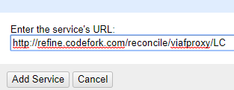
Adding a reconciliation service
Reconcile → start reconciling
Add Standard Service
Enter URL of service
Click Add service
Working (it may take a little bit)
Your service should appear in the list if successfully added
Notes:
If you’ve never used a given reconciliation service

Slide 20
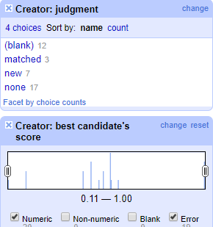
Reconciliation facets
Matched: the service found a near-exact match
None: matches might (or might not) have been returned, but need review
New: Manually flagged for further review
Notes:
DEMO Begin running LC-Viaf Proxy reconciliation on Contributor column; after running, either discuss facets or return to slides
Once the reconciliation service has finished running, OpenRefine opens some facets to help you with QC. Last week, I covered facets in great detail mentioned that it’s important to know that as you change data, facets update; always be cognizant when making changes of which facets are open/active, how many rows/records you are working with at a given time (always check at upper left). This is especially important when you have the judgement:none facet selected, since as you match, the data on the screen will change. I missed a lot of matches once this way.

Slide 21
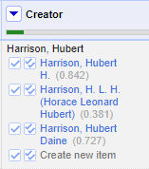
Reviewing matches
Single check matches just that cell
Double check matches all cells with that value
As you approve matches via checkboxes, the rows are removed from the “None” facet
Notes:
Now we can select matches. The VIAF conciliator service provides you with up to 3 possible matches. If you’re not sure if the choice you’re thinking of selecting, click the name and take a look at the LC/NAF record. The single check matches just that cell, and the double check matches all cells with that value. Note that if you have many pages in your data, clicking the double check will scroll you back to top of the first page.

Slide 22
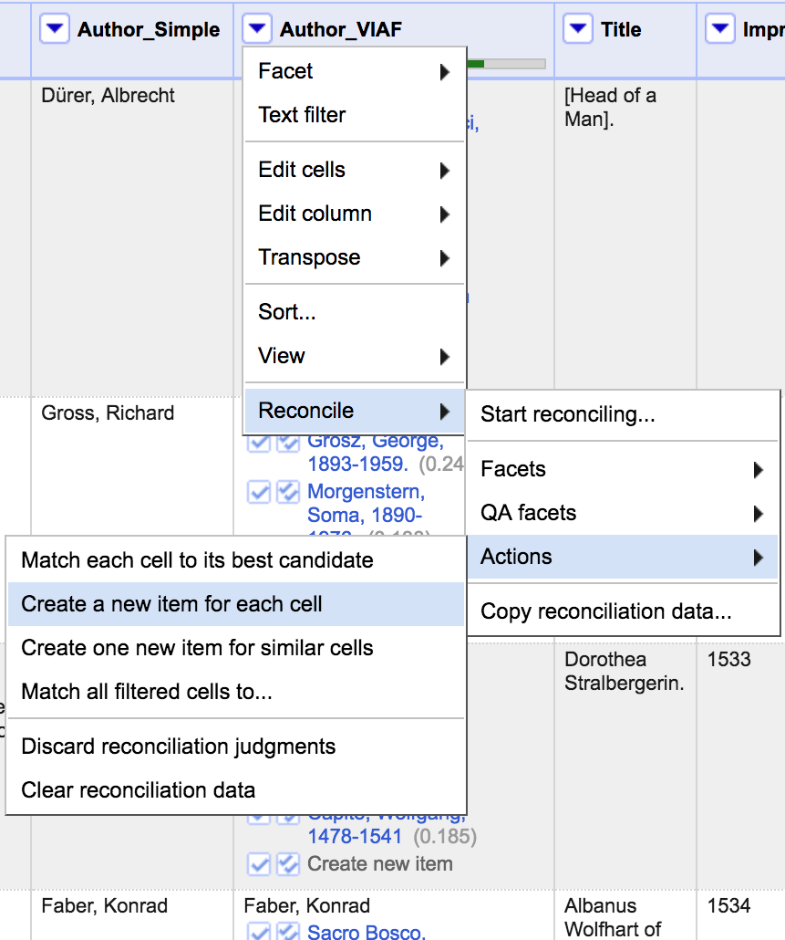
Other reconciliation actions
Batch application of matches
Creating new items: akin to starring / flagging -- adds cells to a “new” reconciliation facet to help filter for further review
Discarding judgments: saves reconciliation data, but removes all matches
Clear reconcilation data: wipes all reconciliation data
Notes:
AP Note that sometimes, the tool doesn’t give you the result you expect. You can either leave the cell unreconciled, or mark it as new to help yourself find it via faceting later. In the case of Derick Baegert, the records are not quite clustered right in VIAF: we have three separate records from different sources for this artist. It’s up to you to choose the record that best fits your needs.

Slide 23
Exercise 1
Run the Conciliator reconciliation service LC/NAF by VIAF proxy on the Creator column. Use type “Person”
Review the facets--what has matched, what hasn’t matched?

Slide 24
GREL: extract URIs and names
GREL: cell.recon.match.id : just grabs identifier (not always a full URI)
"http://id.loc.gov/authorities/names/"+cell.recon.match.id
GREL: cell.recon.match.name : grabs the preferred form or label of the reconciled term (some reconciliation services let you specify a preferred language and retrieve the preferred version of the term in that language)
Notes:
Now that we’ve matched all we want to match, make sure to clear the facet. Now we can extract the URI and name for each matched record using GREL, or General Refine Expression Language. We’ll add a new column based on the reconciled column, and first enter some GREL to extract the id. We can actually modify the GREL right in OpenRefine to turn it into the VIAF URI, which you can see on the VIAF record page under “permalink”. We can also add the display name from VIAF.

Slide 25
Exercise 2
Using your reconciled Creator column:
Run Edit column→Add column based on this column, twice, using GREL to:
Extract the LC/NAF URI
Extract the preferred label from LC/NAF
Don’t worry--the GREL you need is in your cheatsheet

Slide 26
Wikidata reconciliation
OpenRefine comes “pre-loaded” with a very powerful Wikidata reconciliation service. The service has a couple nice added features that set it apart:
“Search for new match” enables you to edit values without re-running reconciliation
Built in “Data Extension API” that makes it easy to pull in other data from the Wikidata record

Slide 27
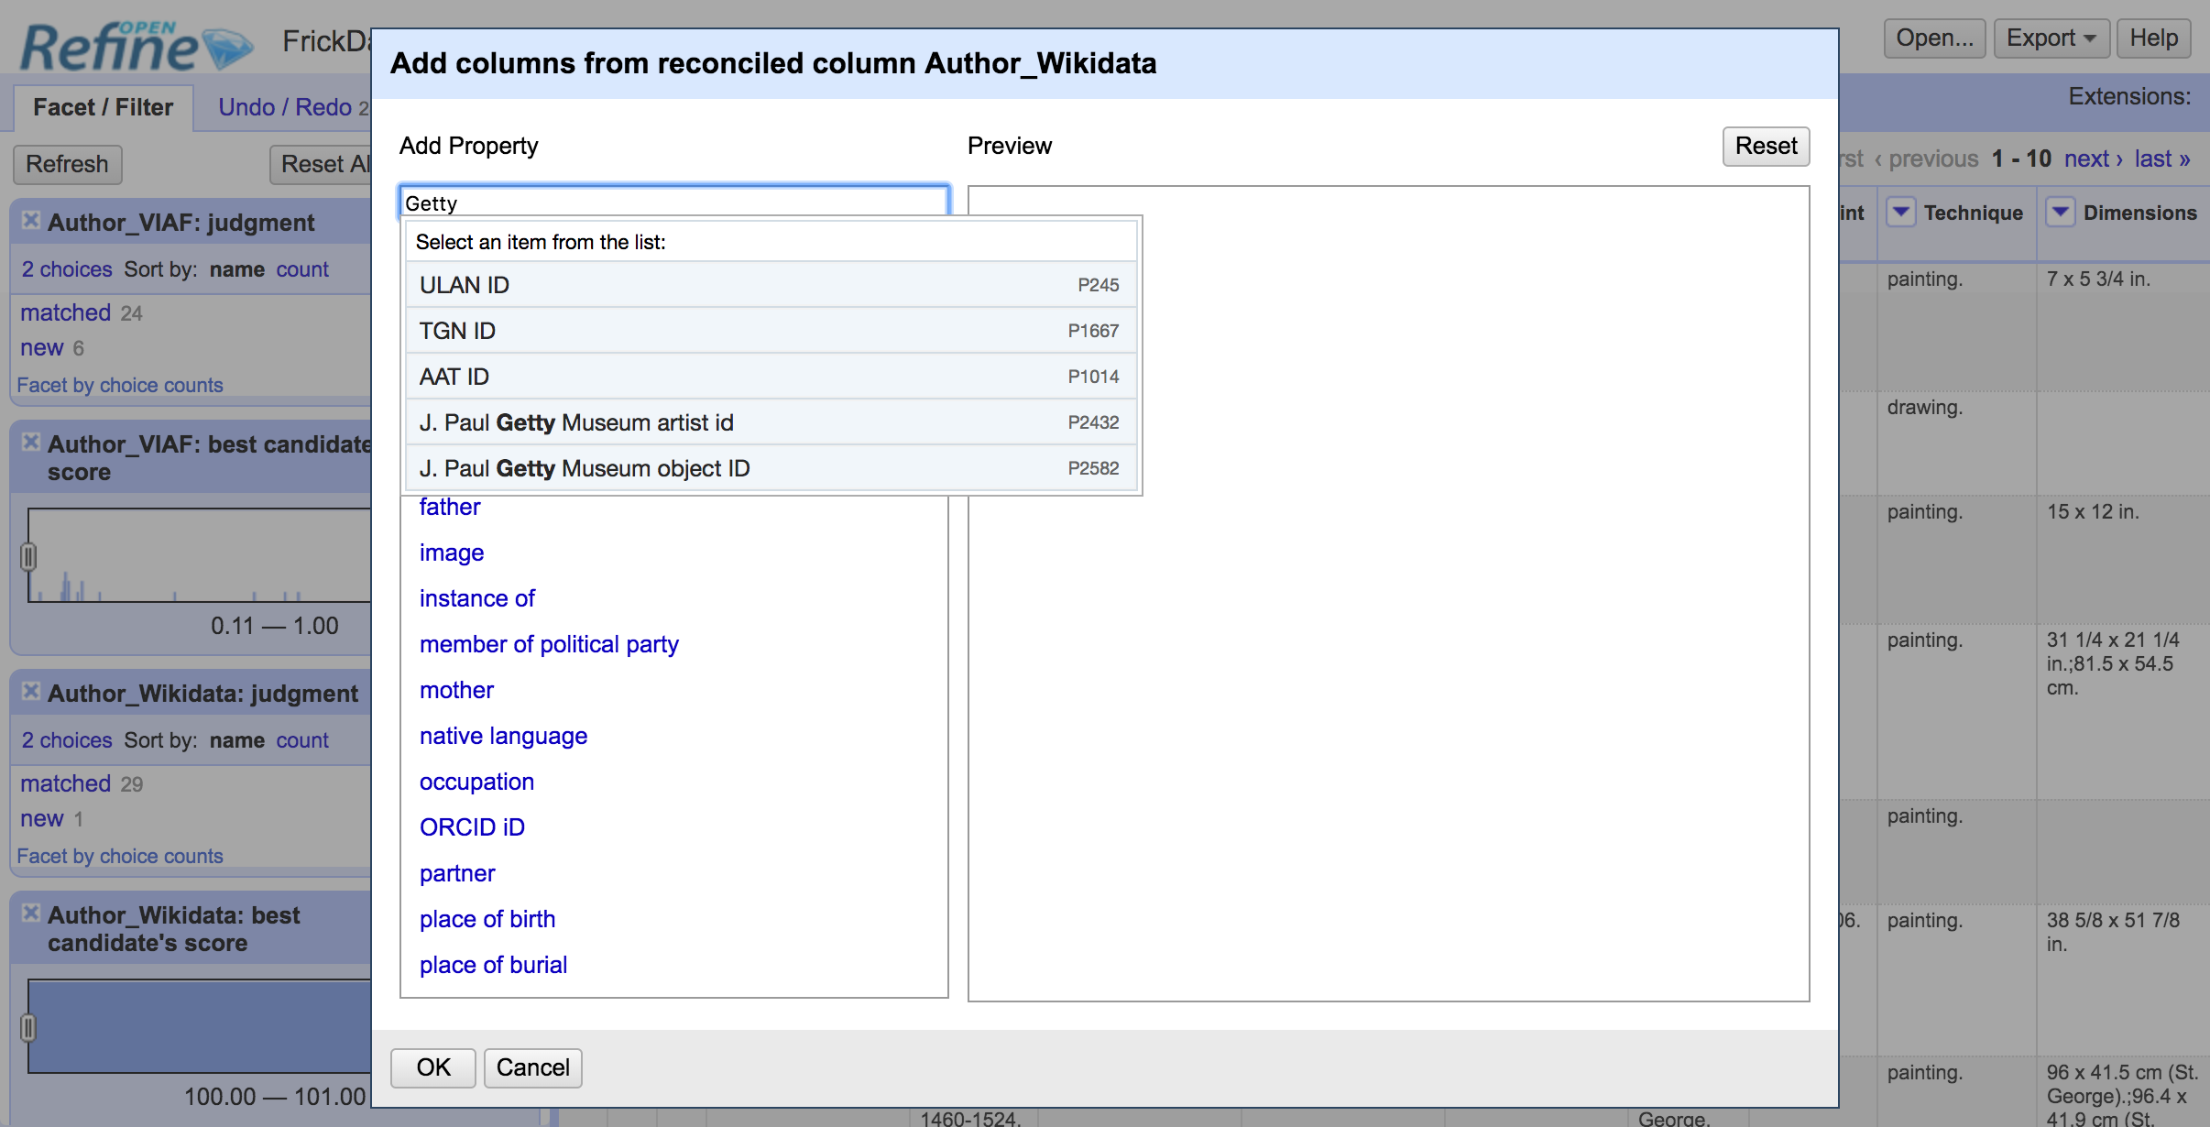
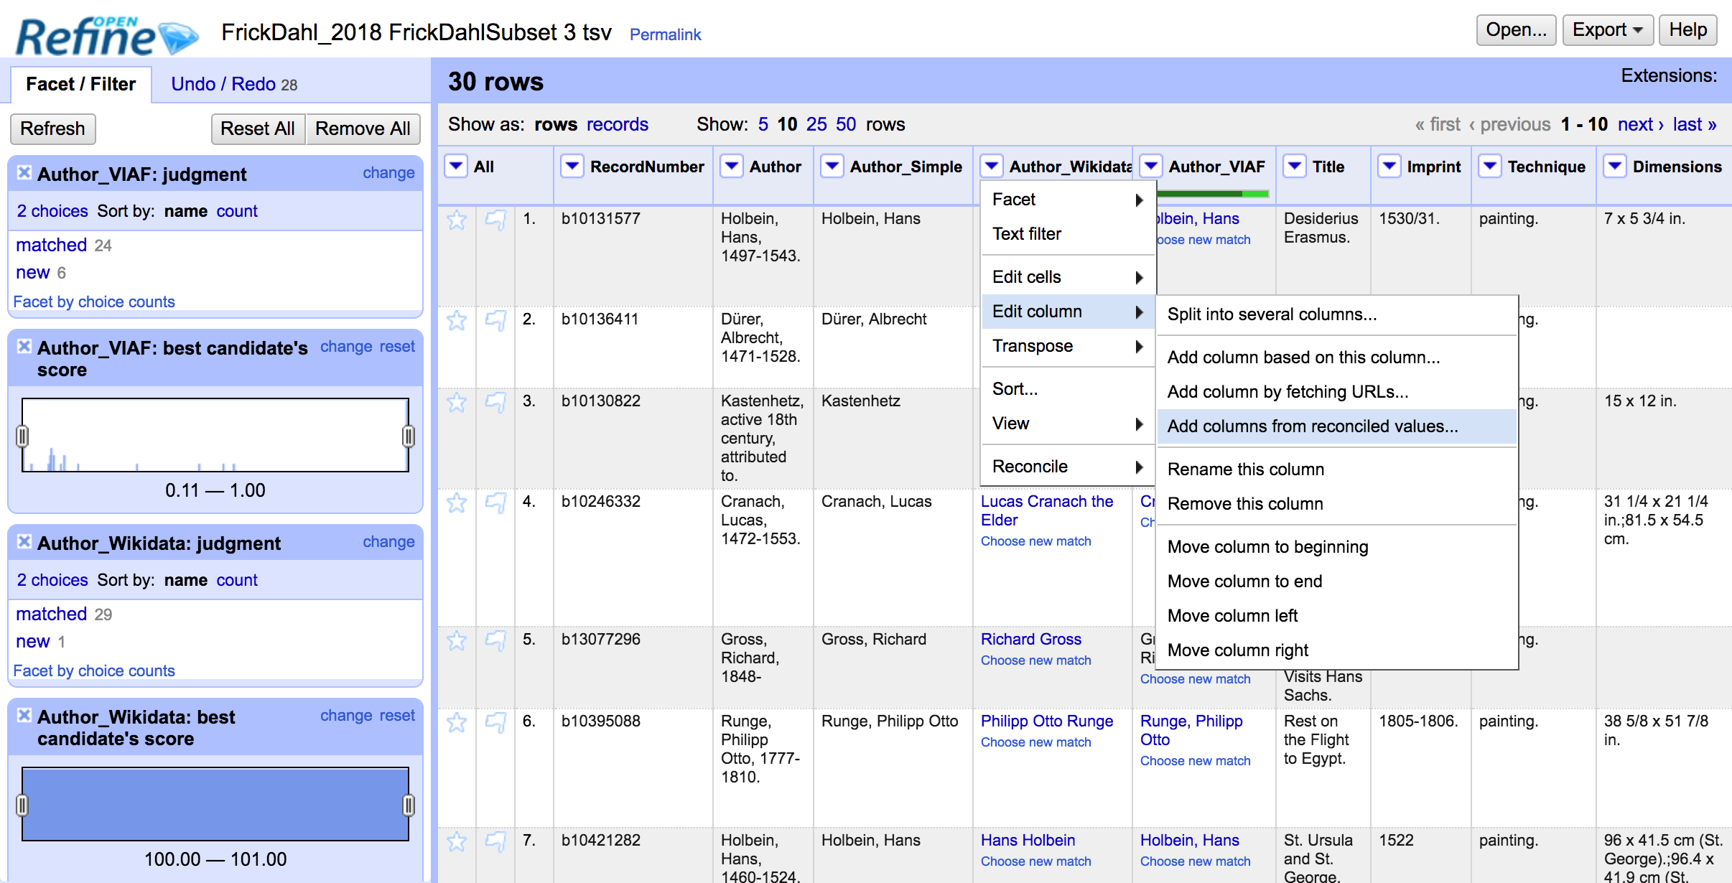
Wikidata: use Data Extension API
Notes:
AP
The Wikidata reconciliation service also works with the new OpenRefine Data Extension API. We can grab data like birth date, sex or gender, ULAN ID, and image. We can even select VIAF ID, which I’ve used during QC to compare and double check results.

Slide 28
Exercise 3
Use the Creator column again
Reconcile → Actions → Clear reconciliation data
Run the Wikidata reconciliation service, use type Human
Confirm some matches
Once you’ve gotten some reconciled values:
Edit column→ Add column based on reconciled values
Add a column with another property from Wikidata!
Remember--OpenRefine will suggest a list of Wikidata properties, but you are not limited to this list

Slide 29
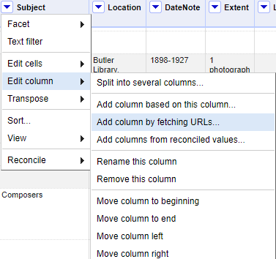
Querying APIs and other web data
Edit column→ Add column by fetching URLs

Slide 30
Querying APIs and other web data
Edit column→ Add column by fetching URLs
This function enables you to pop your cell values into a URL, and then the results of calling the URL are returned in a new column
Use this to “scrape” even unstructured data: no limit on what’s returned--you can get the entire HTML code of a given page
But most efficient for working with APIs and endpoints
In the ensuing demos and exercises, don’t worry about understanding the queries, the JSON, the SPARQL, and GREL--focus on understanding what’s happening more broadly

Slide 31
Querying APIs and other web data
Disadvantages (versus using a custom reconciliation service)
Slower (and some websites may lock you out)
More error-prone
More cleanup of reconciled data needed
Better suited for “known-item” searching
Advantages
Lightweight: no custom reconciliation service needed
Flexible: can work with lots of kinds of online data sources
Direct access to data unmediated by reconciliation
Can get more than just identifier/URI and authorized heading
Notes:
There are many disadvantages to this approach: it tends to take longer--unlike a reconciliation service, we are essentially sending a bunch of queries to a website, like trying to open up a bunch of pages in a browser simultaneously. This can easily overload your computer, the OpenRefine application, the API or endpoint receiving these dozens/hundreds/thousands of discrete queries simultaneously, or all of the above. In many instances, even websites with publicly accessible APIs will shut you out after you overload them with many queries in a given timespan--in some cases you can get an API key to enable more access, but this is not always possible. For a number of reasons, the process tends to be less reliable and more error-prone: you may have to test out a few iterations of your query before landing on a version that returns good results for your source dataset. The results, in our case in JSON (but the task can also return HTML or a number of formats), are not in a human-friendly format. This can make choosing between multiple possible matches daunting, and can also make it difficult to extract the right URIs and preferred terms from the results. For all of these reasons, the approach of pulling data from API and endpoint calls without the aide of a reconciliation service tends to work best with “known-item” types of searches -- that is, you have the correct term in your data but need to get the URI.
There are, however, advantages to this approach--it’s lightweight, so it doesn’t need any plugins or custom reconciliation services to function. It’s also very flexible and can be used to return data from just about any website, although the way the website is encoded, its structure, or the way a web service returns data may greatly affect how well you can actually use the data you get from “fetching URLs.” [API calls are often reliable but you may need an authentication key to be able to make bulk calls to a public API]. The flipside of this last point is that, depending on what online data source you’re querying, the data returned may be more appropriate for your needs. For example, if you need to get JSON, RDF, XML, or other formatted data from an external source via an API call, “Add columns by fetching URLs” may be less convoluted than going through reconciliation.

Slide 32
OCLC FAST API
FAST: Faceted Application of Subject Terminology
Derived from LCSH to optimize online searching and navigating
Has 8 categories of terms--we’ll look today at Topical
API returns XML and JSON
GREL has functions to parse JSON

Slide 33
OCLC FAST API
Sample query:
http://fast.oclc.org/searchfast/fastsuggest?query=VALUE&rows=30&queryReturn=suggestall+idroot+auth+cscore&suggest=autoSubject&queryIndex=suggest50&wt=json
This query in GREL: See your “cheatsheet”
Parsing out URI from returned results: Use GREL in your “cheatsheet”
Notes:
DEMO:
Show the FAST Autosuggest API interface
https://platform.worldcat.org/api-explorer/apis/fastapi/LinkedData/Autosuggest
Show the sample query in a browser
http://fast.oclc.org/searchfast/fastsuggest?query=Theater&rows=30&queryReturn=suggestall+idroot+auth+cscore&suggest=autoSubject&queryIndex=suggest50&wt=json
Run the Add column by fetching URLs task on the Subject column [in test on dataset, this took 4 minutes to run]
"http://fast.oclc.org/searchfast/fastsuggest?query="+ value.replace(/[\s\-\.\,\:\(\)]/,"%20") +"&rows=30&queryReturn=suggestall%2Cidroot%2Cauth%2cscore&suggest=autoSubject&queryIndex=suggest50&wt=json"
On the new column, run an Edit cells → Transform task with the GREL
forEach(value.parseJson().response.docs,v,if(v.auth == row.record.cells.Subject.value[0],"http://id.worldcat.org/fast/"+substring(v.idroot,3),"")).uniques().join("")

Slide 34
Exercise 4
Edit Cells → Split multivalued cells in Subject. Split on semicolon
On Subject column: Edit column → Add column by fetching URLs
Insert GREL expression with FAST query from cheatsheet
Switch to Rows view
Use the second GREL expression on the cheatsheet to parse the URIs out of the returned JSON

Slide 35
Exercise 4: Notes
What happened? The FAST API is a bit problematic--it will return duplicate hits as well as some very unexpected results, chiefly because of how variant versions of a term are indexed.
The first GREL expression puts our cell value into an API call (a URL), replacing values that will gum up the FAST API
The second GREL expression looks at the returned results, compares them to our source column Subject, grabs the FAST identifier, de-dupes, and then reformats the FAST identifier to a URI

Slide 36
Getty Vocabularies: SPARQL Endpoint
http://vocab.getty.edu/queries
SPARQL = Sparql Protocol and RDF Query Language
SELECT ?x ?label
{
?x skos:inScheme aat:;
(xl:prefLabel|xl:altLabel)/gvp:term "painting"@en;
skos:prefLabel ?label
FILTER(lang(?label)="en").
}
Notes:
DEMO:
Show the vocab.getty.edu site
Run the query
Run a version of the query in a separate window via URL
The Getty Vocabularies SPARQL endpoint at http://vocab.getty.edu/queries
For documentation and sample queries (as well as an additional query submission form), see http://vocab.getty.edu/queries#Finding_Subjects
While searching a source like Wikidata may work well with names, with form and genre metadata, it is likely to return far too many results, since the terms themselves may be quite general--think of how many hits would be returned if you searched Wikipedia, FAST, or LC for “Painting,” “Fiction,” or “Manuscripts.”
It is still possible to use OpenRefine to match your metadata with one of the authoritative sources in this domain, the Getty Art and Architecture Thesaurus, but the process is a bit more complex. Getty provides what is known as a SPARQL endpoint for accessing the rich linked data of its vocabularies, but it is not currently set up to permit the creation of an OpenRefine reconciliation service. Fortunately, we can use another useful feature of OpenRefine: The “Add column by fetching URLs” command.
In today’s example, we will use the Getty Vocabularies’ SPARQL endpoint. A SPARQL endpoint is a publicly accessible query interface (a bit like an API) that makes data accessible via SPARQL queries. The underlying data is formatted as RDF (or one of its many serializations, such as JSON-LD, Turtle, N-Triples, RDF-XML). As with our demonstration and exercise taking data from the OCLC FAST API, we will take data from our dataset in OpenRefine, and instruct OpenRefine to plug it into a SPARQL query, which it sends to the Getty SPARQL endpoint as a URL. The data returned from our query will be used to populate the cells of a new column. We can then extract what we need via a GREL expression.
Please refer to the text file that you downloaded at the start of the workshop: you’ll want to copy and paste in the SPARQL queries as we work together
MOVE TO LIVE DEMO
We’ll first look at the Getty Vocabularies SPARQL endpoint--please go to the web address given in the text file
Then, let’s run a query together--we will ask the endpoint to return items in the Art and Architecture Thesaurus which have the label “painting”
Please paste in the first query from the text file--note that it runs over several lines, beginning with SELECT and ending with a closing curly brace.
The query should return a single hit: painting (image-making)
Although we couldn’t possibly hope to get into very much detail about SPARQL in this short workshop, let’s look a bit more closely at our example query. Counterintuitively, the first line tells the query processor what results it wants; in our case, these are arbitrary variables. The stuff between the curly brackets tells the query processor to assign specific query results to our variables. In our case, the ?x will contain the URI for a Getty Vocabulary item, and the ?label variable will contain the corresponding human-readable label for the item. Moving through the stuff in the curly braces: the first line says that we’re interested in all values ?x in the scheme Art and Architecture thesaurus. This limits the results to content from AAT rather than including content from all Getty Vocabularies (ULAN, TGN, etc.). The second line says that for all values ?x within AAT, we are interested in those with an English-language preferred or variant label containing “painting.” The next line assigns the ?label variable to the preferred label of ?x. Finally, we filter the ?label variable only to return the English-language preferred label.
RM: LEAVE live demo and go to explanatory text for next slide
Let’s click on the link on this screen and explore the Getty linked data a bit--we don’t need to get too into the weeds now, but if you plan on doing more reconciliation via the SPARQL technique,
You’ll have to be familiar with both your own data and the structure of the data at the endpoint you’re querying (the Getty vocabs)
Now that we have a feel for the Getty endpoint and linked data interface, let’s run more or less the same query in OpenRefine--we’ll
Use the “Add column by fetching URLs” task; instead of providing a static value for our query, we’ll instruct OpenRefine to plug in the values from each cell in our column
It should take a minute or two to run. Once the task finishes, it creates a column of JSON data--we still have a bit of work to do!

Slide 37
Exercise 5
Using the FormMezzanine column, run an Add column by fetching URLs task with the following query (see your cheatsheet):
'http://vocab.getty.edu/sparql.json?query=select+?x+?label{?x+skos:inScheme+aat:;(xl:prefLabel|xl:altLabel)/gvp:term"' + escape(value, 'url') + '"@en;skos:prefLabel+?label+filter(lang(?label)="en").}'
On the returned results, Edit Cells→ Transform with GREL:
forEach(value.parseJson().results.bindings,v,if(v.label.value == cells["Form"].value,v.x.value,"")).uniques().join("")

Slide 38
Exercise 5: Notes
What happened? Although Getty often specifies that a preferred version of a term have a qualifier, like “paintings (visual works),” including the qualifiers will invalidate your query. Without the qualifier, Getty’s SPARQL endpoint will often return multiple results, but we are only interested in one.
Therefore, I pre-processed the data to have a FormMezzanine column without the qualifier, but our second GREL script looks at our source column Form, compares the results returned from the Getty API, and grabs the URI of the result that matches the qualified version of the term in the Form column

Slide 39
“Crossing” datasets
GREL’s “cross” function can help us in the following instances:
Querying web sources can be slow
Some online datasets may only, or alternately, be made available as “data dumps” rather than through APIS or endpoints
Some local controlled vocabularies may be inaccessible to the web, e.g. locations

Slide 40
“Crossing” datasets
Today’s use case: CUL locations (CUL_DLC_Locations.tsv)
Not all CUL locations are represented in LC/NAF
Some CUL locations prefer a local label for web display over the LC/NAF label
CUL locations: small dataset
CUL locations: local controlled vocabulary in Hyacinth inaccessible to web queries

Slide 41
“Crossing” datasets
The second dataset needs to be loaded into your OpenRefine instance
The Cross function compares the value of a cell with the values in a specified column of the second dataset
If a match is found in 2nd dataset, the Cross function can pull in other data from that row in the second dataset
Notes:
Let’s do a quick demo on the Language column (don’t worry, you don’t have this dataset)

Slide 42
Exercise 6
If you haven’t already, create a project with the file CUL_DLC_Locations.tsv ; name the project CUL_DLC_Locations
Using the the Collection column:
Edit column → Add column based on this column
GREL Expression (see your cheatsheet)
cell.cross('CUL_DLC_Locations','Label').cells['URI'].value[0]

Slide 43
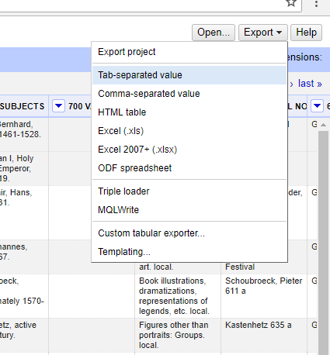
Exporting your data
To get your data out of OpenRefine:
Click Export (at the top right of screen)
Pick a data format
The file will appear in your default downloads folder
Exporting a project
Export → Export project
This exports both your data and the entire editing history since you loaded it into OpenRefine
Can be opened by another instance of OpenRefine
Notes:
RM
OpenRefine saves your project automatically, so….
Unless you uninstall the program, or install a new version (or something awful happens to your hard drive). . .
No need to worry--your data will still be there when you reopen OpenRefine!
RETURN TO DEMO
Show data export options
Explain project export (data plus editing history) -- why might you want the project, why might you just want the data?

Slide 44
Resources
http://openrefine.org/
Homepage has basic tutorials, Documentation has links to mailing lists, wikis, and Downloads has links to the GitHub page
van Hooland, Seth and Verborgh, Ruben. Linked data for libraries, archives and museums : how to clean, link and publish your metadata. London : Facet Publishing, 2014. 9781856049641
A more in-depth exploration of the linked data world, with many examples of how to use OpenRefine
Stuart, David. Practical ontologies for information professionals. Chicago : Neal-Schuman, an imprint of the American Library Association, 2016. 9780838915110
A very deep dive into linked data, the semantic web, and ontology development
Notes:
Here are some resources. . .

Slide 45
Resources ctd.
Reconciliation services
Conciliator by Jeff Chiu: https://github.com/codeforkjeff/conciliator
Wikidata reconcile: https://tools.wmflabs.org/openrefine-wikidata/ (Installed by default in OpenRefine 2.8+)
Other reconciliation services:
fast-reconcile: https://github.com/timothy-mendenhall/fast-reconcile
lc-reconcile: https://github.com/cmh2166/lc-reconcile (last updated 3 years ago)
Getty AAT: https://github.com/ettorerizza/aat_reconcile (just released, still buggy)
SPARQL
DuCharme, Bob. Learning SPARQL. Sebastopol, CA : O'Reilly Media, 2013. 9781449371432
Library Juice Academy: Certificate in RDF- and XML-based systems: the SPARQL fundamentals pt. 1-3. http://libraryjuiceacademy.com/certificate-xml-rdf.php
Notes:
Here are some resources. . .

Slide 46
Resources ctd.
Data sources
https://github.com/OpenRefine/OpenRefine/wiki/Reconcilable-Data-Sources
BARTOC (Basel Register of Thesauri, Ontologies, and Classification): https://bartoc.org/ : a list of possible data sources (e.g. controlled vocabularies)
SPARQL endpoints
W3C list of publicly available SPARQL endpoints (not exhaustive): https://www.w3.org/wiki/SparqlEndpoints
Additional endpoints not on W3C site:
The British Museum: http://collection.britishmuseum.org/sparql
Getty Vocabularies: http://vocab.getty.edu
CIA World Factbook (SNORQL and HTTP SPARQL endpoint): http://wifo5-04.informatik.uni-mannheim.de/factbook/
Linked Jazz: https://linkedjazz.org/sparql/
OCLC API Explorer: https://platform.worldcat.org/api-explorer/apis
Notes:
Here are some resources. . .

Slide 47

Questions?
Ryan Mendenhall
trm2151@columbia.edu
Notes:
QA 5:50-6PM

